Slide 1
GP HW11 (CH 13)
Solution

Slide 2
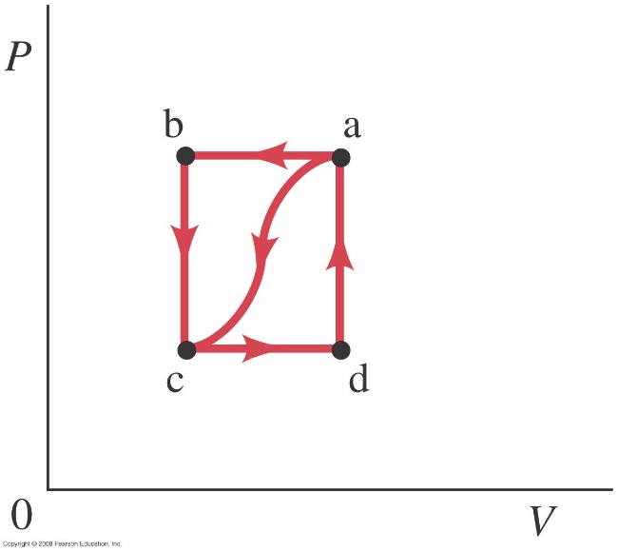
HW13-1 Problem 19-39 and 19-40 in Giancoli (pp. 524)
19-39. In the process of taking a gas from state a to state c along the curved path shown in Fig.19–32, 85 J of heat leaves the system and 55 J of work is done on the system. (a) Determine the change in internal energy, (b) When the gas is taken along the path cda, the work done by the gas is W = 38 J. How much heat Q is added to the gas in the process cda? (c) If how much work is done by the gas in the process abc? (d) What is Q for path abc? (e) If what is Q for the process bc? Here is a summary of what is given:
19-40. Suppose a gas is taken clockwise around the ­rectangular cycle shown in Fig.19–32, starting at b, then to a, to d, to c, and returning to b. Using the values given in Problem 39, (a) describe each leg of the process, and then calculate (b) the net work done during the cycle, (c) the total internal energy change during the cycle, and (d) the net heat flow during the cycle. (e) What percentage of the intake heat was turned into usable work: i.e., how efficient is this “rectangular” cycle (give as a percentage)?

Slide 3
Sol: for 39
(a)
(b)
(c)
(d)
(e)

Slide 4
P
b
a
Sol: for 40
(a)
ba: isobaric expansion, and the work done is positive.
ad: isovolumetric/isochoric reduction in pressure, and the work done is 0.
dc: isobaric compression, and the work done is negative.
cb: isovolumetric/isochoric expansion in pressure, and the work done is 0.
(b)
c
d
V

Slide 5
(c) For a cycle
(d)
(e)
P
b
a
c
d
V

Slide 6
HW13-2 Problem 19-55 in Giancoli (pp. 524)
A 1.00-mol sample of an ideal monatomic gas, originally at a pressure of 1.00 atm, undergoes a three-step process: (1) it is expanded adiabatically from T₁ = 588 K to T₂ = 389 K; (2) it is compressed at constant pressure until its temperature reaches T₃ (3) it then returns to its original pressure and temperature by a constant-volume process. (a) Plot these processes on a PV diagram. (b) Determine T₃. (c) Calculate the change in internal energy, the work done by the gas, and the heat added to the gas for each process, and (d) for the complete cycle.
Sol:
(a)

Slide 7
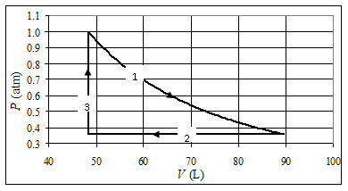
(b)
From the graph in part (a):
(c)
(1)→(2) adiabatic

Slide 8
(2)→(3) isobaric
(3)→(1) isochoric/isovolumetric
(d) For the complete cycle
(must be zero)

Slide 9
HW13-3
A thermal cycle runs clockwise from A to B, then C and finally D with straight lines and the pressures and the volumes for each point are shown in the figure on the right.
Calculate the work done by each process.
Calculate the change of internal energy in each process. (assume diatomic gas.)
Rank the intake heat 𝑄_{𝐴→𝐵} , 𝑄_{𝐵→𝐶} , 𝑄_{𝐶→𝐷} and 𝑄_{𝐷→𝐴} , as it moves reversibly from points A, B, C, and D.
All the answer should be in terms of P₀V₀.
P
A
3P₀
 | △E | Q | W
A→B
B→C
C→D
D→A
D
B
2P₀
P₀
C
V
V₀
2V₀
3V₀

Slide 10
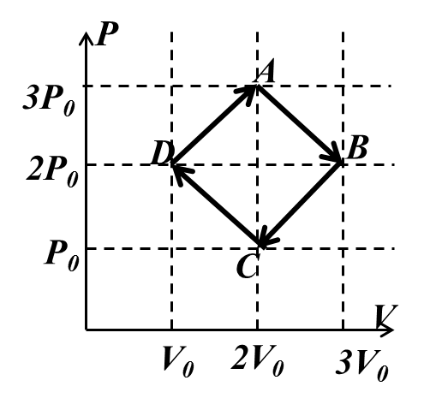
Sol:
(a)
A➔B
C➔D
B➔C
D➔A

Slide 11
(b)
diatomic gas➔
(只和 有關 )
A➔B
B➔C
C➔D
D➔A

Slide 12
(c)
已知 E 和 W
➔
A➔B
B➔C
C➔D
D➔A

